Slide 1

OVERVIEW OF BIGDATA

Slide 2
History of Big Data
Hadoop started as part of Nutch Project
Inspired by seminal whitepaper by Google in 2004 on a new programming model to handle the data of Internet scale.
In Jan 2006 Dough Cutting started working on Hadoop
In Feb 2006 became full scale project to help Yahoo
In Sep 2007 first release of Hadoop came out
In Jan 2008 Hadoop became top level project in Apache projects

Slide 3
What is Hadoop ?
This is solution for addressing problem of big data
Distributed Parallel processing
Built in backup and fail-over mechanism
Easily scalable and Economical
Efficient and Reliable
This is based upon design of Google GFS and BigTable
A framework for storing & processing Petabytes of data using commodity hardware and storage

Slide 4
Tale of Distributions
Apache Hadoop
Cloudera Hadoop
Hortonworks Hadoop
MapR Hadoop
AWS EMR

Slide 5
Choice of Languages
Java
Scala
Python
R

Slide 6
Separation of concerns
Storage
Processing/Transforming engine
OLAP/OLTP engine
Ingestion systems
Cluster Management
Scheduling
Security

Slide 7
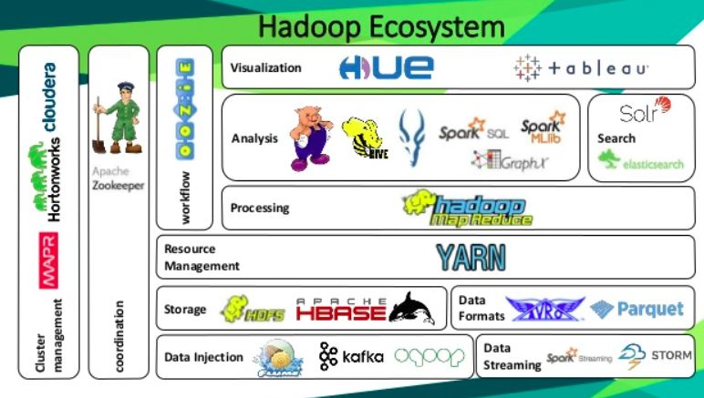
Ecosystem

Slide 8
Roles in Hadoop
Hadoop Developer
Hadoop Admin
Solution Architects

Slide 9
Components covered
HDFS
Spark
Hive
Map Reduce – Intro only
Yarn
Kafka
HBase

Slide 10
Emerging Techs
Flink
Ignite
Druid
Drill
Azure

Slide 11
Connect with Me
Email – shubham899@outlook.com
Linked In – https://www.linkedin.com/in/shubham-anil-gupta-1689ab137/
GitHub - https://github.com/shum979
Blog - https://sparkfuturetech.wordpress.com/

